Slide 1

Speaker: Mike Jadoo

Slide 2
Agenda
About Machine Learning
Supervised Learning
R
Fishing dataset -Case study
Supervised ML Model (Regression)

Slide 3
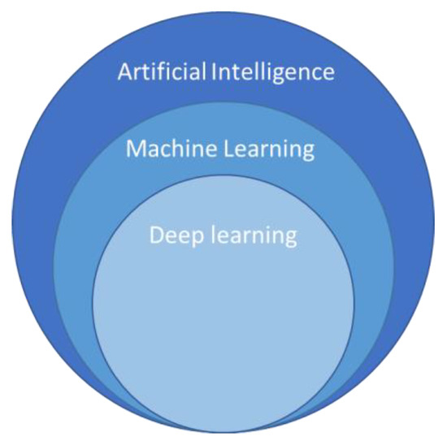
Machine Learning
Machine Learning
Unsupervised Learning
Supervised Learning
Clustering
Regression
Classification

Slide 4
Supervised Learning
Machine Learning
Supervised Learning
Regression

Slide 5

R and Data Science process
Collection
Cleaning
Exploring
Modeling
Deployment

Slide 6
Data Story - Fishing Market

Slide 7
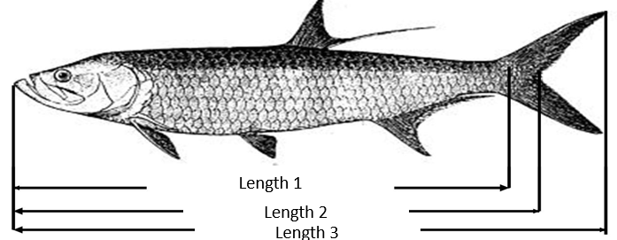
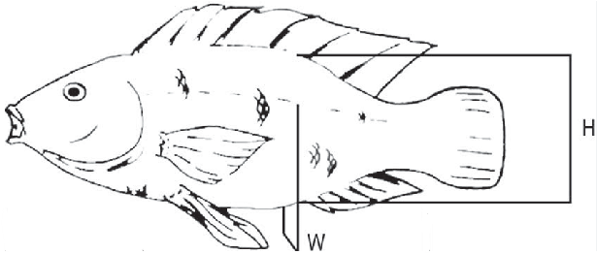

Fishing dataset -Case study
Weight

Slide 8
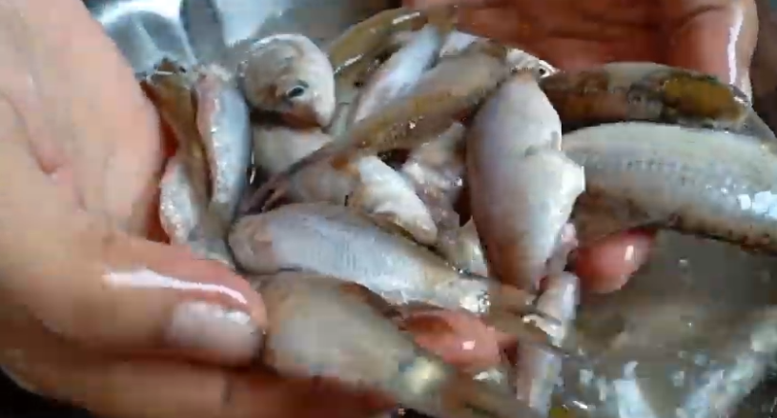


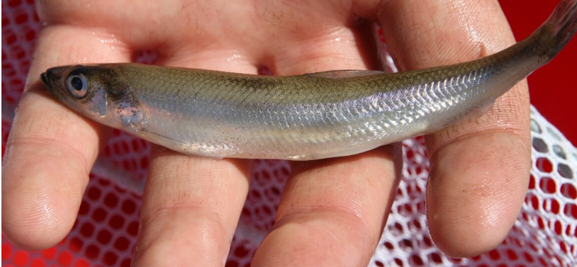



Species
Parkki
Parkki
Parkki
Parkki
Parkki
Parkki
Parkki

Slide 9
Supervised ML Model (Regression)

Slide 10
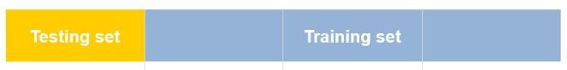
Supervised ML Model (Regression)
Cross Validation:
Types of validations:
Random Split
Time-Based Split
K-Fold Cross-Validation

Slide 11
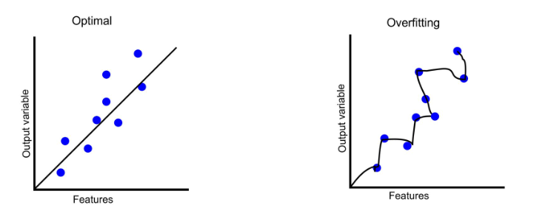
Overfitting
Training R² > Test R²

Slide 12
Model evaluation measures
MSE – average squared difference between the predicted and actual values
RMSE-The square root of the mean squared error
R2- proportion of the variance for a dependent variable that's explained by the independent variable

Slide 13
Linear Assumptions
Normality: For any fixed value of X, Y is normally distributed
Homoscedasticity: The variance of residual is the same
Independence: Observations of the independent variables are not dependent

Slide 14
The model-Predicting weight of a fish by certain variables
lm(formula=Weight ~ Height+ Width+Length1+Length2+ Length3, data=trainSet)

Slide 15


Slide 16
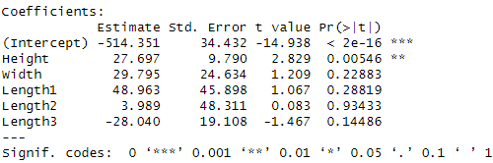
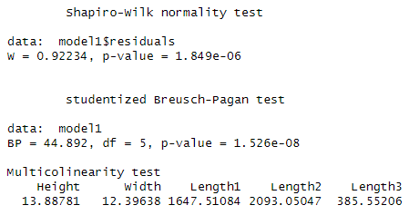
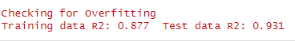
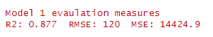
Model 1 metrics
Model parameters
Linear Assumptions
Check for overfitting
Model Evaluation

Slide 17
New model based on coefficients (Research Tip)
Some variables are not significate. Why?

Slide 18
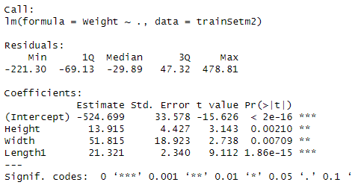
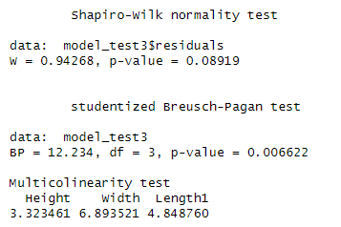
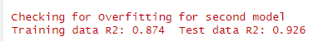
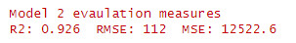
Model 2 metrics
Model parameters
Linear Assumptions
Check for overfitting
Model Evaluation

Slide 19

What did we learn? Is this the best way?

